Slide 1
Review : A hybrid model for spatiotemporal forecasting of PM2.5 based on graph convolutional neural network and long short-term memory
Sungkyunkwan University (SKKU), Korea
Presented by LEE SEONGGU
Notes:
Good afternoon.
In this time, I’ll introduce my proposed model and my paper which I’m writing
The paper name is Hybrid Model of Convolutional LSTM and CNN to Predict Particulate Matter.
This presentation is silmiar to last presentation but something is change in detail to explain more easily.

Slide 2
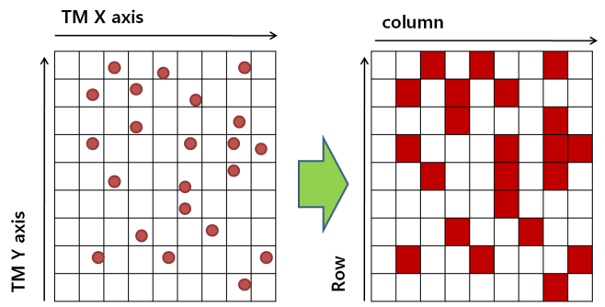
Problem Definition (In our research)
A disadvantage of ConvLSTM
All dataset have to be processed in form of grid matrix.
Actually, measurement stations are not fully matched in grid.
Blank cells can be generated.
Station
Blank Cell = There are no measurements.
Notes:
Main topic is Particulate Matter (PM).
It is a very small mixture of solid particles and liquid droplets found in the air.
This can get deep into your lungs and some may even get into your bloodstream.
So, It is dangerous for human body.

Slide 3
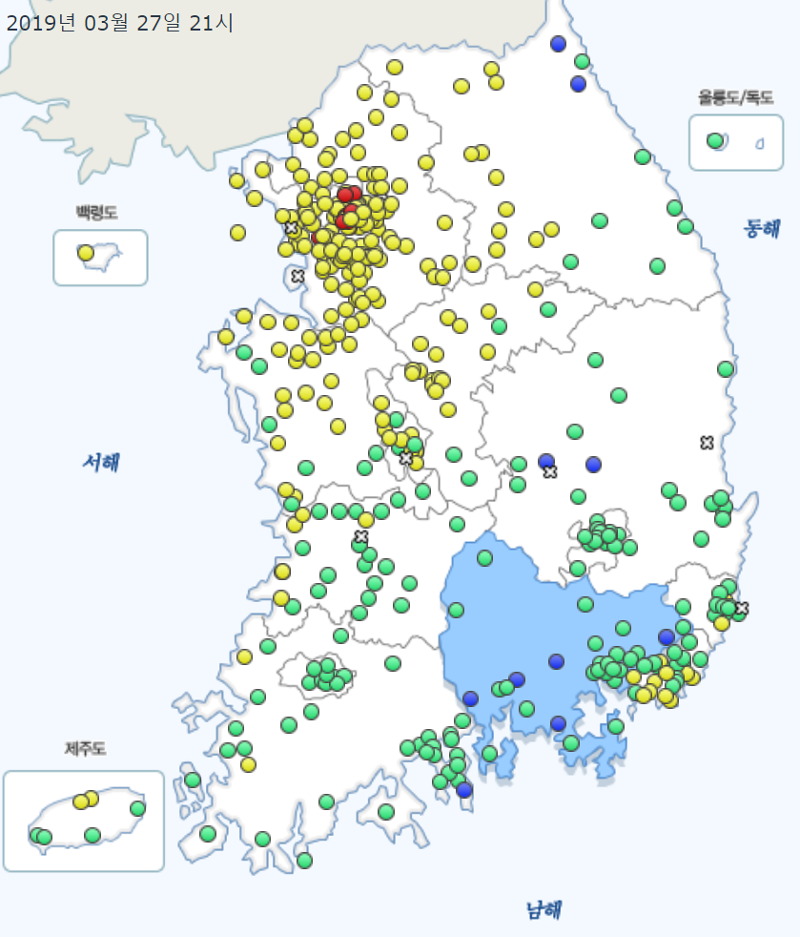
Problem Definition (In our research)
Necessity to extend a measuring station range.
Predict more far time series. -> Consider inflow of other area. -> Use larger measured area. -> Generate more blank cells.
Large area = sparse
Small area = dense
Notes:
To predict more far time series, Inflow of other arr
Wind effect. -> It is important to use larger measuring area to predict more far time series.

Slide 4
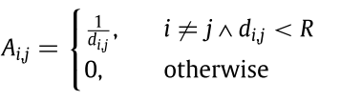
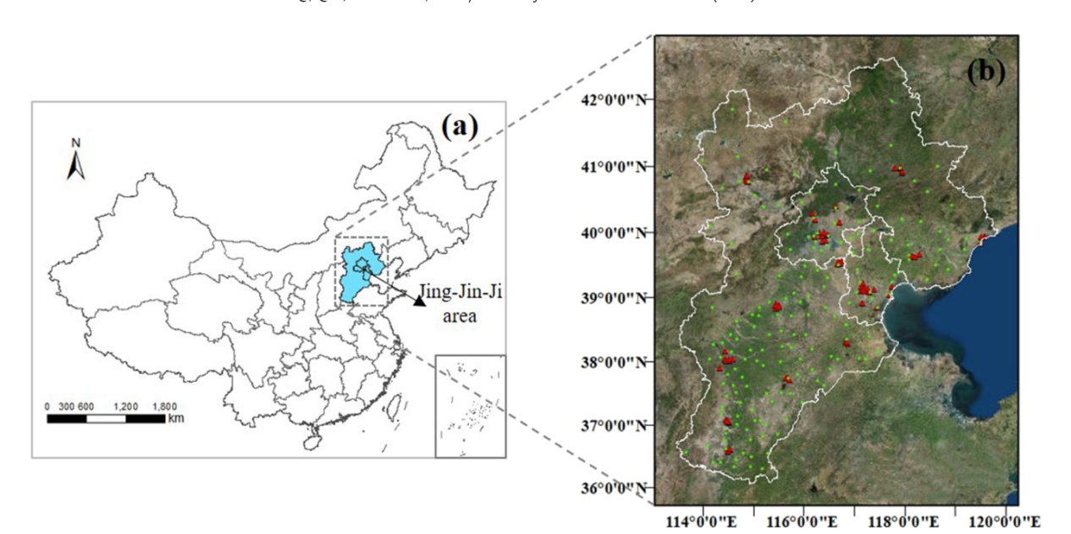
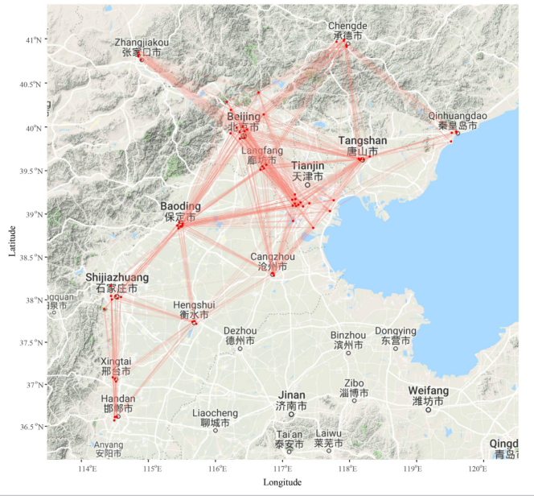
Theoretical Background
graph convolutional neural network(GCN)
Graph construction.
(1) -
G =(V, E, A)
Distribution of stations
Connected stations in graph
Notes:
In this paper, they use GCN to model spatio-temporal PM data
Explain G
V,
E, Edge
A, Adjacent matrix
reciprocal of distance
Xt ∈ R(N×M): feature matrix
N is station nodes.
M is number of features of N monitoring stations.
element
According to the definition of graph structure, the input features of N monitoring stations at each time t can be
M is the number of features associated with each node. Spatial rela-
translated to graph signals as a feature matrix Xt ∈ R
N×M where
tionships existed among different locations can be represented as an undirected graph G =(V, E, A)with N nodes vi ∈ V (includ- ing all the stations in study area) and each edge
? vi, vj ?
A ∈ RN×N is the spatial weight matrix, where each element Ai,j
∈ E.
represents the quantitative spatial correlation between vi and vj (Ai,j

Slide 5
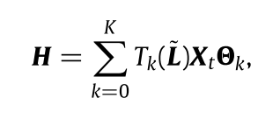







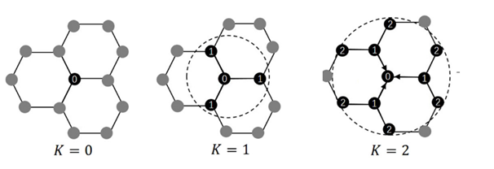
Theoretical Background
graph convolutional neural network(GCN)
graph convolutional operation
: Chebyshev polynomial
spatial feature matrix :
for all station at time t
: Input
: Filter matrix
: Normalized graph Laplacian matrix
Notes:
Calcualtation is little bit difficult
H is the spatial feature matrix
Tk(s) is the k-order chebyshev polynomial
L : normalized graph Laplacian matrix
Tilde L : scaled Laplacian
람다 max : the largest eigenvalue of L
이러한 연산에 의해,
각 feature에 dependent한 training weight가 생긴다.
(단, station에는 independent함)_
Support = 1 일 때,
Tk는 s가 된다. 즉, normalization된 ~L
Xt ∈ R(N×M): feature matrix
N is station nodes.
M is number of features of N monitoring stations.
According to the definition of graph structure, the input features of N monitoring stations at each time t can be
M is the number of features associated with each node. Spatial rela-
translated to graph signals as a feature matrix Xt ∈ R
N×M where
tionships existed among different locations can be represented as an undirected graph G =(V, E, A)with N nodes vi ∈ V (includ- ing all the stations in study area) and each edge
? vi, vj ?
A ∈ RN×N is the spatial weight matrix, where each element Ai,j
∈ E.
represents the quantitative spatial correlation between vi and vj (Ai,j

Slide 6

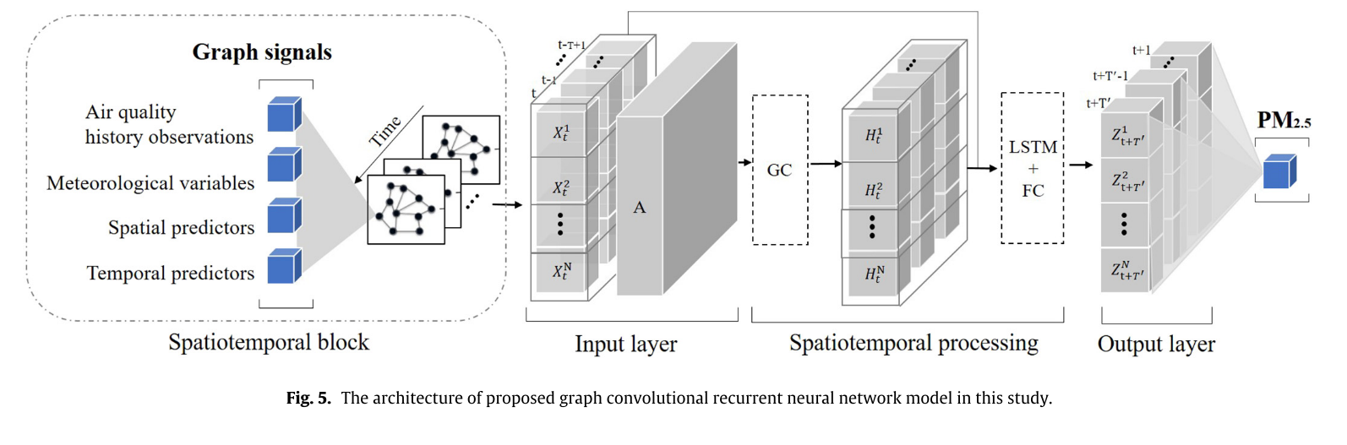
Model
graph convolutional neural network with LSTM
Predict time series of PM2.5
Notes:
이러한 연산에 의해,
각 feature에 dependent한 training weight가 생긴다.
(단, station에는 independent함)_
Support = 1 일 때,
Tk는 s가 된다. 즉, normalization된 ~L
Xt ∈ R(N×M): feature matrix
N is station nodes.
M is number of features of N monitoring stations.
According to the definition of graph structure, the input features of N monitoring stations at each time t can be
M is the number of features associated with each node. Spatial rela-
translated to graph signals as a feature matrix Xt ∈ R
N×M where
tionships existed among different locations can be represented as an undirected graph G =(V, E, A)with N nodes vi ∈ V (includ- ing all the stations in study area) and each edge
? vi, vj ?
A ∈ RN×N is the spatial weight matrix, where each element Ai,j
∈ E.
represents the quantitative spatial correlation between vi and vj (Ai,j

Slide 7
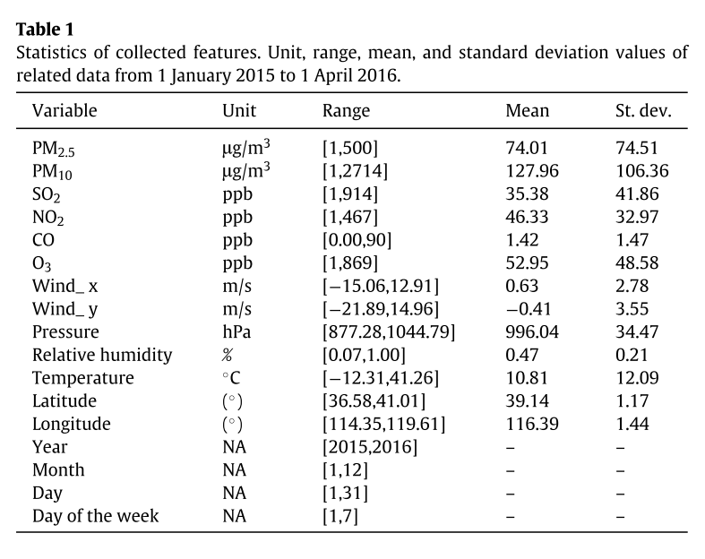
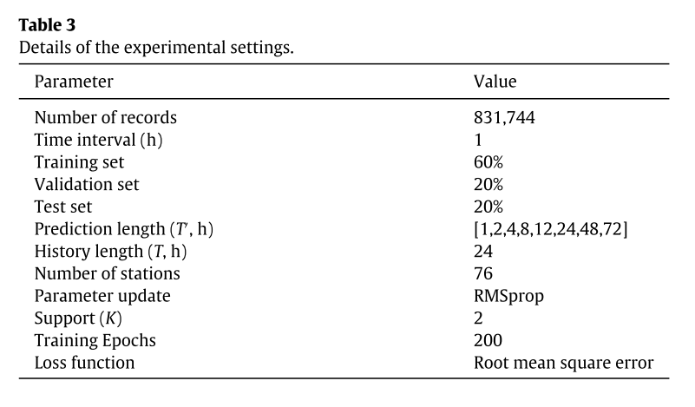
Feature & Parameter
Input parameter
Hyper-parameter
Feature
Notes:
이러한 연산에 의해,
각 feature에 dependent한 training weight가 생긴다.
(단, station에는 independent함)_
Support = 1 일 때,
Tk는 s가 된다. 즉, normalization된 ~L
Xt ∈ R(N×M): feature matrix
N is station nodes.
M is number of features of N monitoring stations.
According to the definition of graph structure, the input features of N monitoring stations at each time t can be
M is the number of features associated with each node. Spatial rela-
translated to graph signals as a feature matrix Xt ∈ R
N×M where
tionships existed among different locations can be represented as an undirected graph G =(V, E, A)with N nodes vi ∈ V (includ- ing all the stations in study area) and each edge
? vi, vj ?
A ∈ RN×N is the spatial weight matrix, where each element Ai,j
∈ E.
represents the quantitative spatial correlation between vi and vj (Ai,j

Slide 8
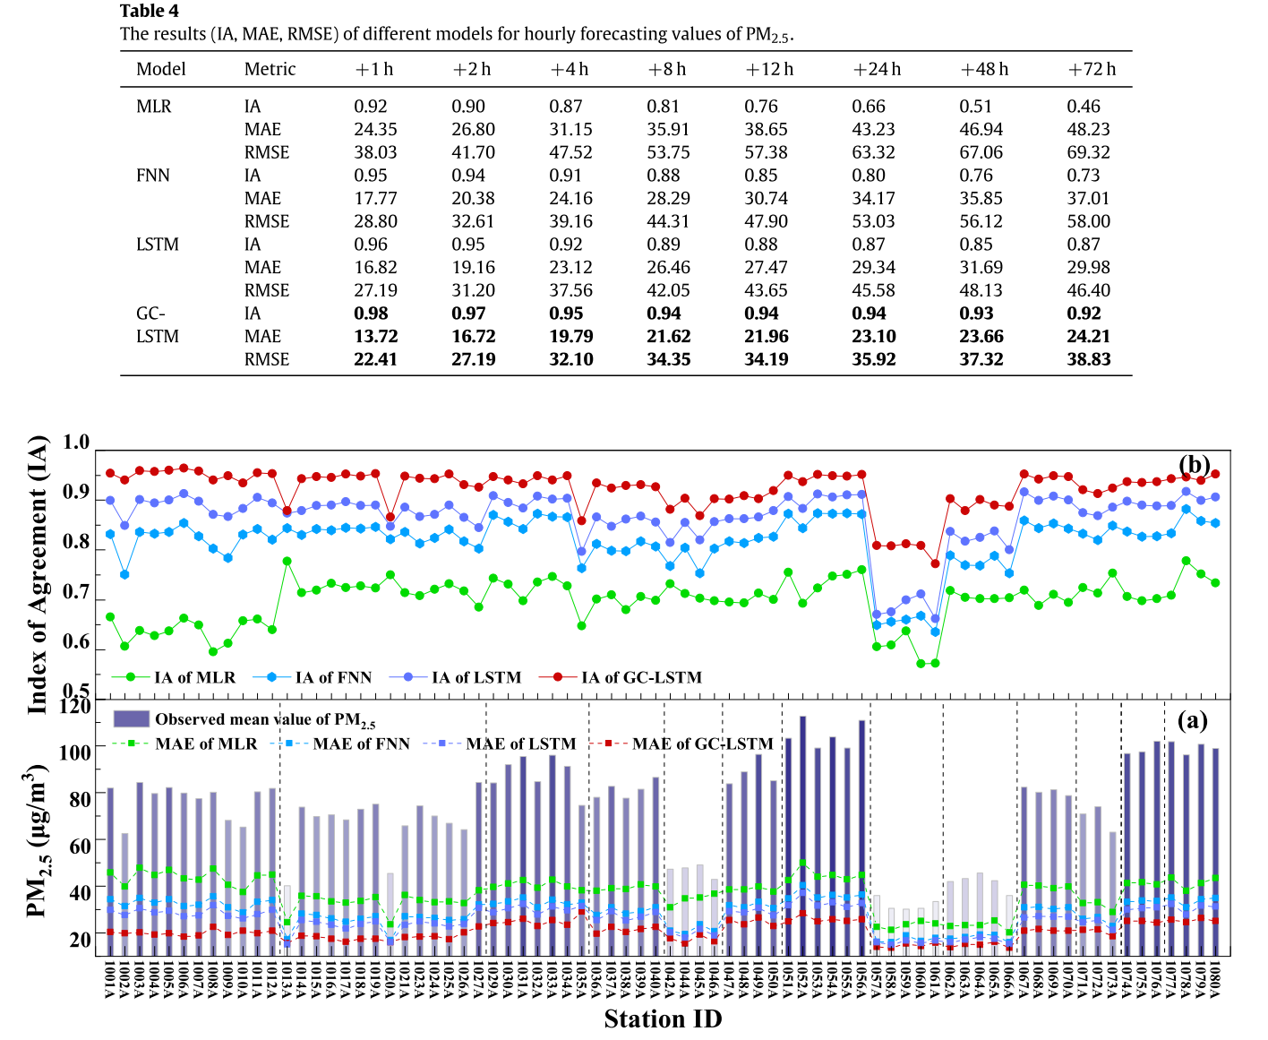
Result
IA, MAE, RMSE for hourly forecasting values of PM2.5
Notes:
multiple linear regression method (MLR) which is widely used in many forecasting problems,
feed-forward neural network (FNN) architecture without considering spatial and temporal dependency and LSTM without considering spatial dependency were used as three baselin

Slide 9
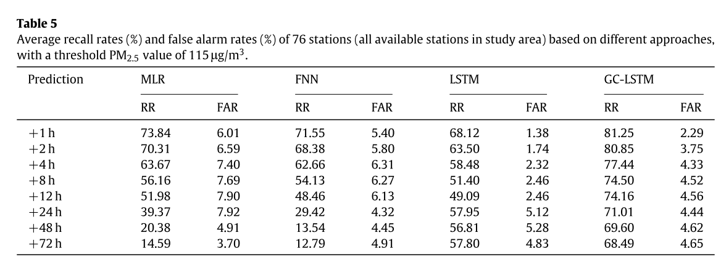
Result
Recall Rates (RR) and False Alarm Rate (FAR)
Predict time series of PM2.5

